Slide 1
Data Analysis for
Prognostics and Health Management
DISTRIBUTION STATEMENT D. Distribution authorized to the Department of Defense and U.S. DoD contractors only for Administrative or Operational Use (25 April 2007). Other requests shall be referred to the TARDEC Executive Office ATTN: AMSRD-TAR / MS #204, 6501 East 11 Mile Road, Warren, MI 48397-5000
U.S. Army Tank Automotive Research, Development and Engineering Center

Slide 2
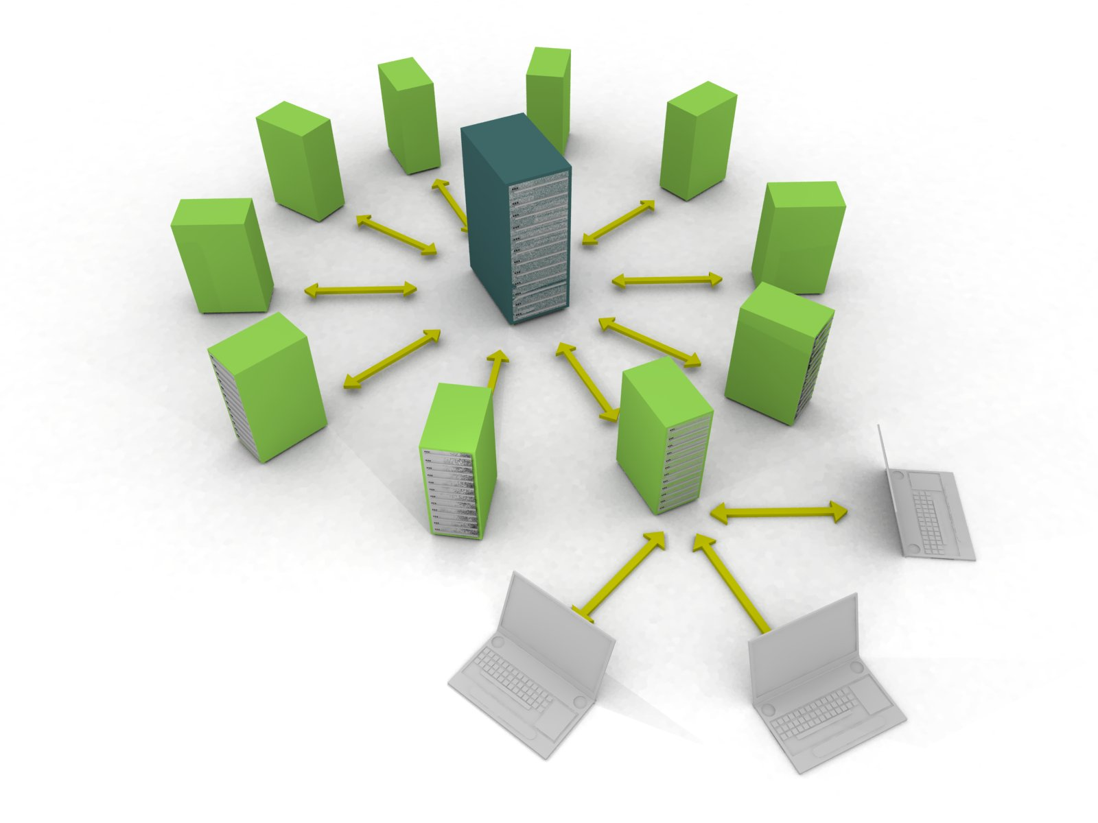
Introduction
CASSI - Analytics - Data Analysis & Optimization
Introduction:
Team is comprised of multidisciplinary individuals with experiences ranging from core engineering expertise to advanced mathematics and software engineering.
Work closely with the Condition Base Maintenance group within TARDEC. Participating with Prognostics and CBM professional communities within industry.
The team is constructing and internal experience stack and tool chain to perform Multidisciplinary Design Optimization.
For Analysis of data sets the team is solidly filled with individuals with strong software engineering skill sets who can easily interface with new systems and standards to rapidly aggregate dispirit data sources for holistic analysis.
Potential Analysis Projects:
Vehicle Subsystem and Component optimization. Trade studies between various component alternatives such as batteries, tires, filters etc.
Analysis of vehicle life cycle measured data and logistics supply chain data to dictate failure criteria based on engineering assumptions, environmental conditions and mission pressures.
Experience
Statistical and Probabilistic Analysis
Structured and Unstructured Data Analysis
Rapid Software Development and Prototyping
Informatics and Information Science, Data Aggregation
Multidisciplinary Design Optimization
Contribution to MDO and Prognostics Communities
Extensive Tool-set Experience

Slide 3
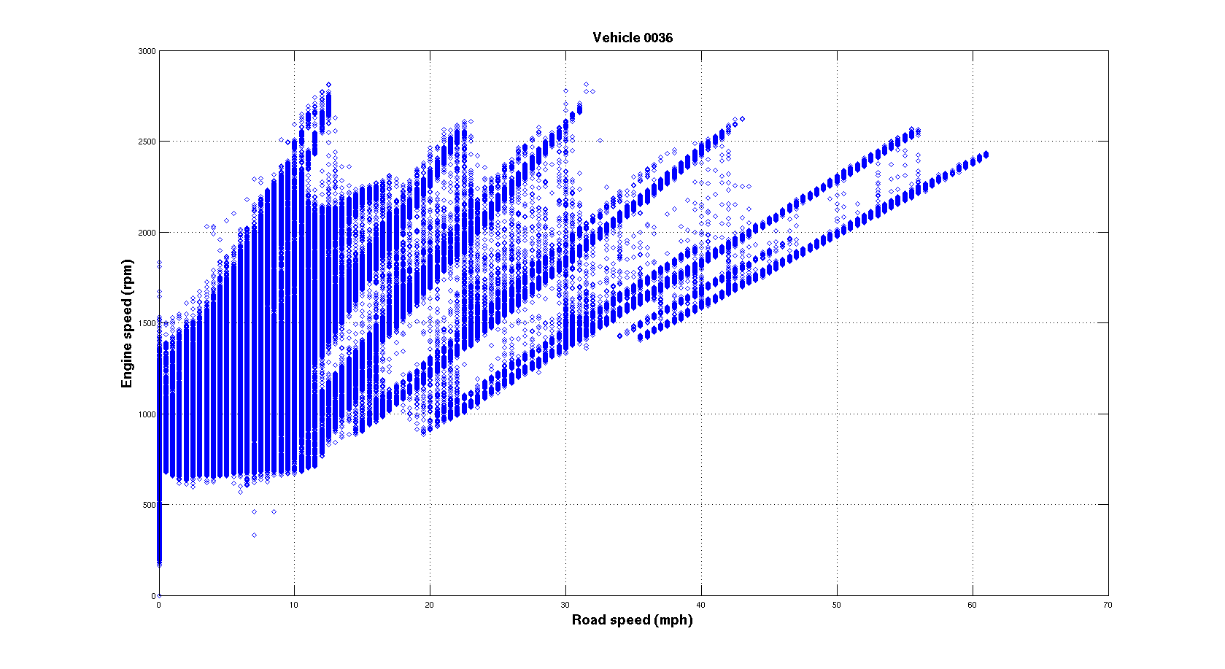
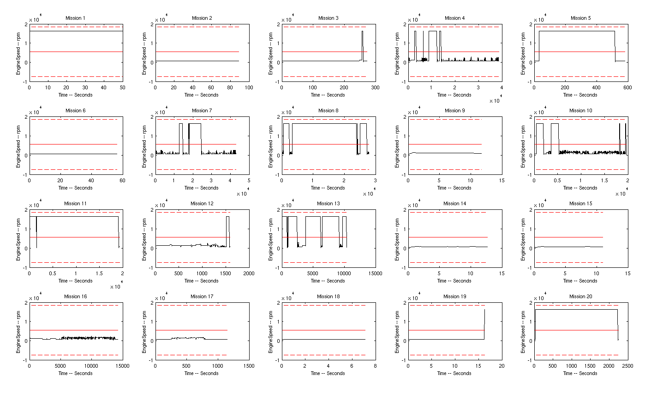
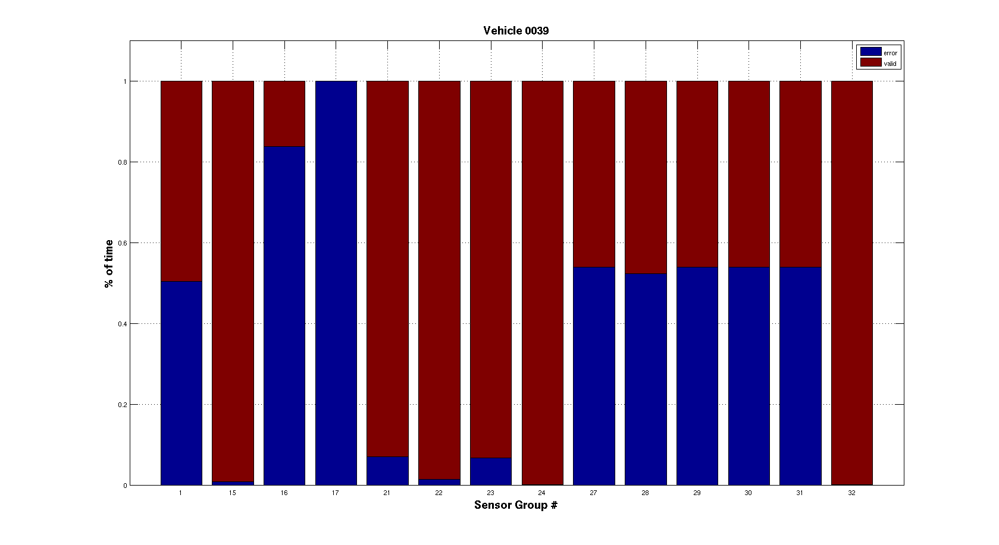
Stryker Data – Approach
Extract data from the provided sets for two Stryker Vehicles.
Massage data with various tool sets, commercial and internally developed.
Gain familiarity with provided information. Attempt to identify anomalies and contextual events.
Apply traditional statistical analysis where discerned as possible.
Investigate possibility of designing machine learning analysis with given data.
Peer review and discussion of individual approaches

Slide 4
Stryker Data – Quick Results
Verification of Data, diagramming the engine (rpm) as it transitions through
Different road speeds. Aggregated for single vehicle over sampling life cycle.

Slide 5
Stryker Data – Quick Results

Slide 6
Stryker Data – Quick Results

Slide 7
Stryker Data – Desired Context
Necessary additional data for value added analysis:
Documentation of all relevant events (Part replacement, etc.)
  Need both nominal and pre-fault sets of sensor data learn how to predict failure
Explicit specifications of the vehicle variant, configuration, operation, etc.
  Variants with different modifications, weights, and mission profiles cannot be assumed to have similar component decay profiles. All of this contextual information must be recorded for valuable analysis.
Explicit specification of the sensor design, behavior and installation*
  Context surrounding what sensor data is incredibly important to assist in identification of sensor fault.
  Sensors will have specific idiosyncrasies that need to be enumerated for proper confidence of analysis.
Desired Additional Information for value added analysis:
Reliable sensor performance, confidence indicators from the experiment designers*
  Appears that more than 1/3 of measured data is unusable
  Possible installation failure, contextual reasoning for enable/disable
Sensor “stale/malfuctioning/max” value of zero instead of arbitrary maximums*
  Arbitrary value reporting will significantly distort means, standard deviation and all other statistical measurements.
  Rejection criteria is unknown due to some max values being in acceptable operational range.
* Possible that through contextual awareness some of these questions would be alleviated, pedigree of data is in question until team is able to discern exactly what intent was from measurement source.

Slide 8
Stryker Data – Possible Future
Traditional Statistical Analysis:
Analysis of Means (ANOM)
Analysis of Variance (ANOVA)
K-means Clustering
  Possible to use various statistics to establish “nominal” sensor data profiles for vehicles with means and standard deviations. If sensor data deviates consistently and far enough from the mean then it can be an indication of failure.
Machine Learning Analysis:
Bayesian Networks (naïve or standard) (BN)
  From nominal and pre-fault data, build a network that is based on current sensor data and gives a failure probability for a component in a given time interval. Use a threshold to indicate when to replace.
Neural Networks (NN)
  Similar to Bayesian Networks, however one gains the ability to utilize nonlinear dependence at the cost of being less transparent.
Hidden Markov Models (HMM)
  At the simplest level; a Bayesian Network with a time history of past sensor readings. This would allow for greater accuracy due to historical information being included in the inference process, but adds to the complexity cost.
Fuzzy Logic Inference
  Combines sensor data inputs with a fuxxy reasoning based rule set (general value as opposed to value models) to give a precise predicted output.
Genetic Algorithm (GA) or other Function based Data Mining
  Look at the entire set of data with events and generate hypothetical failure models. Test and evaluate their efficacy, use the best to create a new batch of models and continue until accurate models are achieved.

Slide 9
DXC'10 - Introduction
Prognostics and Health Management (PHM) Society :
Provide free and unrestricted access to PHM related knowledge.
Promote interdisciplinary and international collaboration in PHM.
To lead the advancement of PHM as an engineering discipline.
DXC'10 Competition:
Sponsored By: NASA Ames Research Center, Palo Alto Research Center, and Delft University of Technology
Diagnostic Algorithm (Part 1)
  Using a provided Java/C++ NASA provided framework create a Diagnostic Algorithm to monitor an electrical system. Identify, Diagnose and offer correctional actions based upon load to the electrical system.
  Framework introduced complexity needed to be overcome
  Electrical system includes batteries, inverters, relays, circuit breakers, resistor/loads, sensors
Data Challenge (Part 2)
  Predict the remaining useful life (RUL) of a specific tool given three scenarios that represent use to RUL and three scenarios that only have use.
  Several methods attempted, Neural Networks, Genetic Algorithms, Distribution fitting

Slide 10
DXC'10 - Introduction
Prognostics and Health Management (PHM) Society :
Provide free and unrestricted access to PHM related knowledge.
Promote interdisciplinary and international collaboration in PHM.
To lead the advancement of PHM as an engineering discipline.
DXC'10 Competition:
Sponsored By: NASA Ames Research Center, Palo Alto Research Center, and Delft University of Technology
Diagnostic Algorithm (Part 1)
  Using a provided Java/C++ NASA provided framework create a Diagnostic Algorithm to monitor an electrical system. Identify, Diagnose and offer correctional actions based upon load to the electrical system.
  Framework introduced complexity needed to be overcome
  Electrical system includes batteries, inverters, relays, circuit breakers, resistor/loads, sensors
Data Challenge (Part 2)
  Predict the remaining useful life (RUL) of a specific tool given three scenarios that represent use to RUL and three scenarios that only have use.
  Several methods attempted, Neural Networks, Genetic Algorithms, Distribution fitting

Slide 11
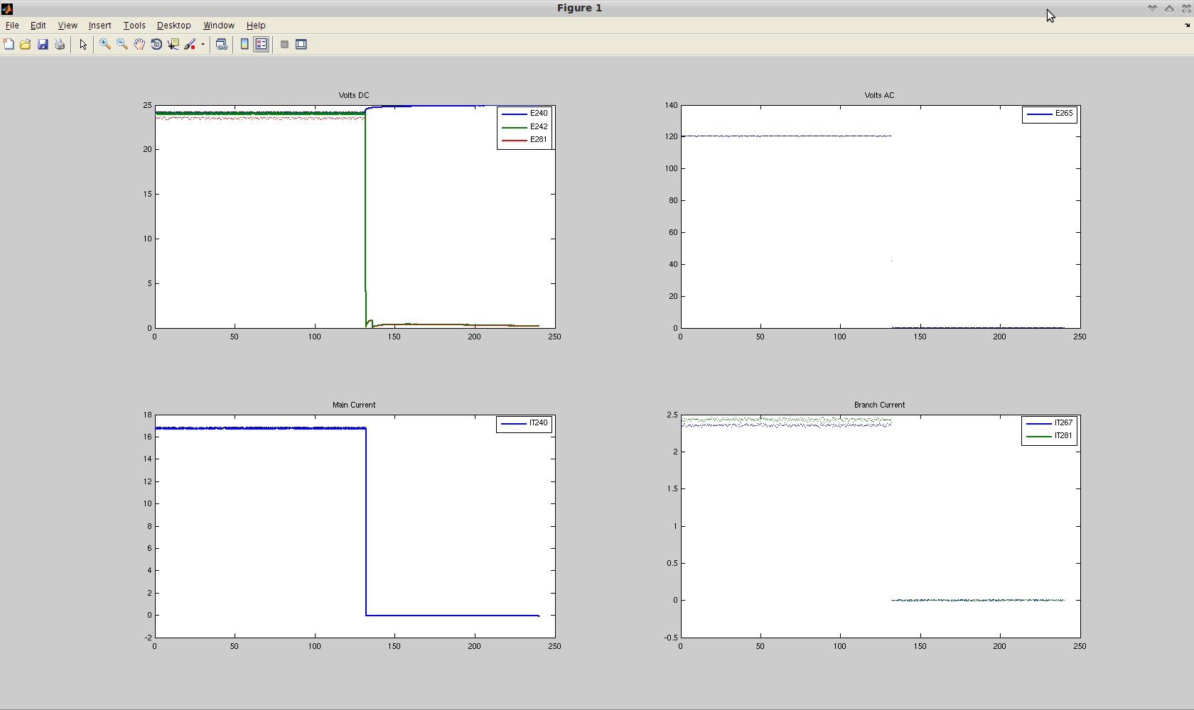
DXC'10 - Example Fault

Slide 12
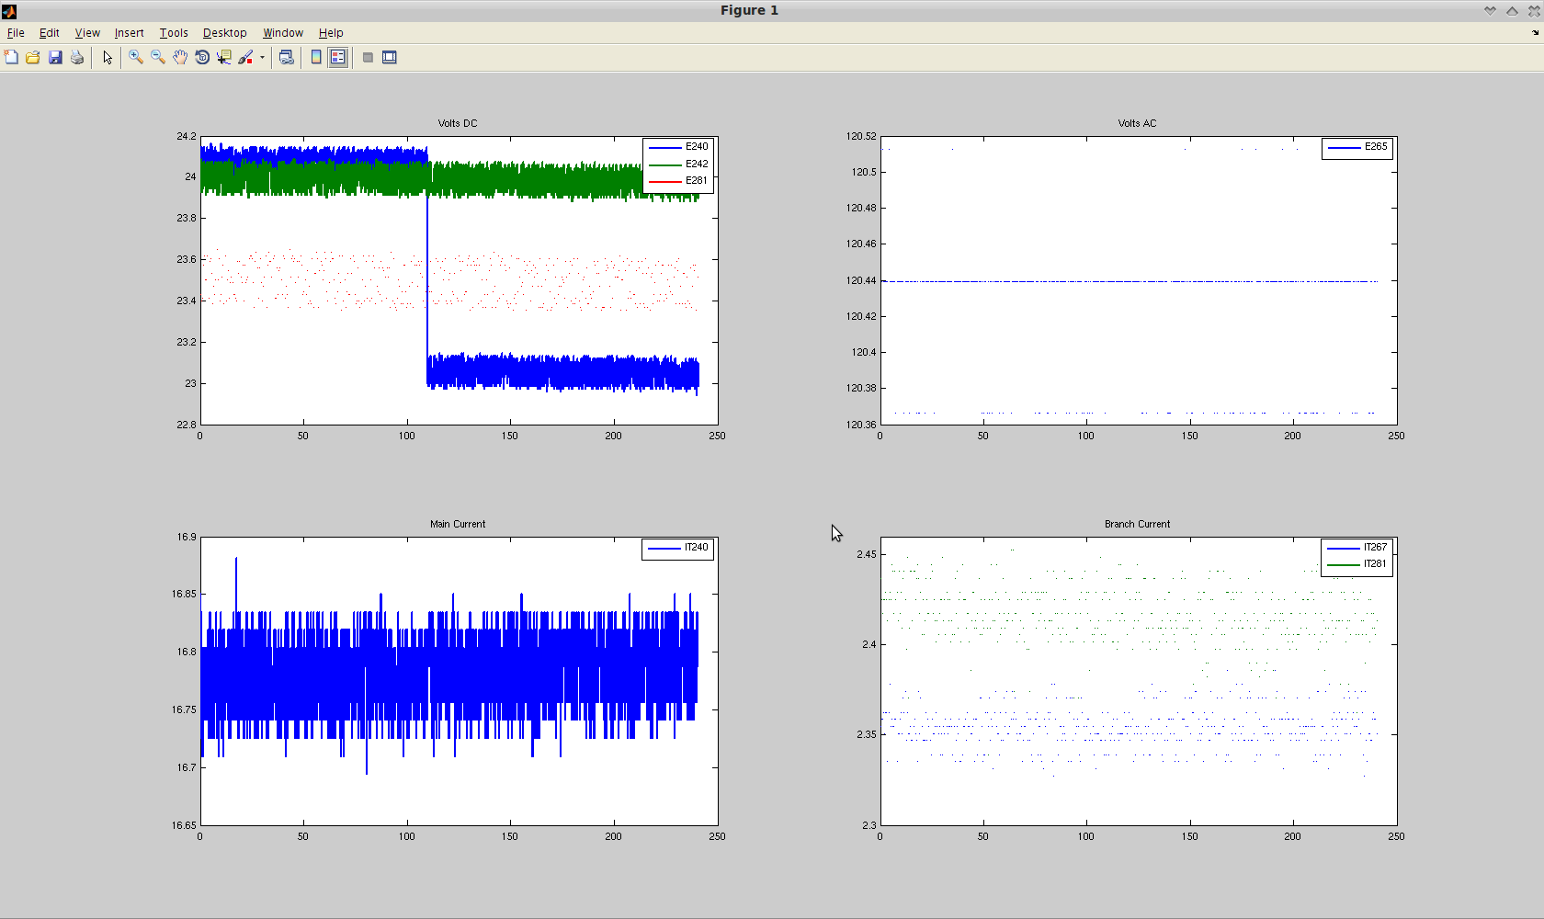
DXC'10 - Example Fault

Slide 13
DXC'10 - Framework
Code Framework:
Developed by NASA Ames Research Lab
C++, Binary (Non-Open Source) and Java codebase
Complex program flow with callback and serialization/threading (Leaky Abstraction)
Discovered Bugs that were submitted to the original developers
Software Development Methodology:
Distributed Version Control System
  Git, Github (Social Coding Resource)
  Commit Early, Commit Often
Rapid Prototyping done in most comfortable language
  Filtering code developed in Matlab, translated to java
  Data processing developed in python, perl and bash depending on simplicity
Peer Review, Social Coding
Discussion of Agile/Extreme implementation, rejected due to leaky abstraction in framework

Slide 14
DXC'10 – Diagnostic Filters
Noise Filtration
Kalman and Particle filter tested
Kalman Filter chosen due to only Gaussian noise being present, in which case a Klaman Filter is optimally conditioned as well as much cheaper computationally
Different state space models considered
Statistical Data Collection
Mean
Standard Deviation
Correlation Coefficient (R2 value)
All data collected in both accumulating and periodic fashion
(Some) Analysis Rules
Sliding Averages over Intervals
R2 correlation thresholds
N*standard deviation thresholds
Etc.

Slide 15
DXC'10 – Diagnostic Filters
Data structure initializations
Rule parameters
While time_i <= time_end
Initial/Interval Restart Kalman Filter Step
Interval FOR loop update sequence
    Online Sensor Statistics and Fault Parameter Update
    Fault Detection Rules
      X (filtered sensor value) jump rules [define step function faults]
      M (filtered sensor slope) jump rules [define steep ramp faults]
      R Correlation threshold rules [define shallow ramp faults]
    Fault Determination Decision Structure
      Filter restart w/inferred fault parameters
      Reinitialize filter at previous time steps to reanalyze data
    End
End
End

Slide 16
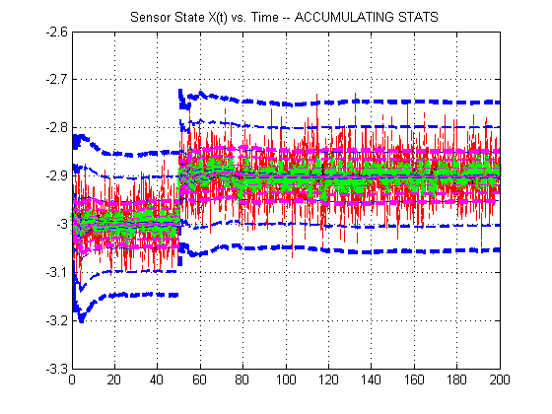
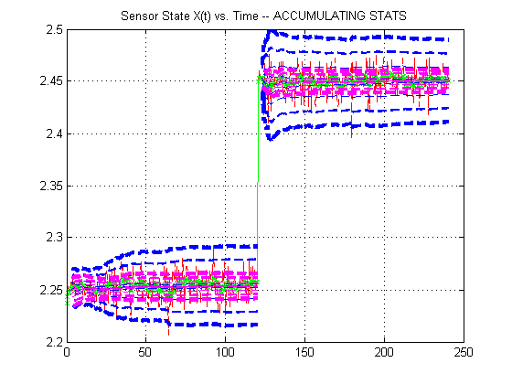
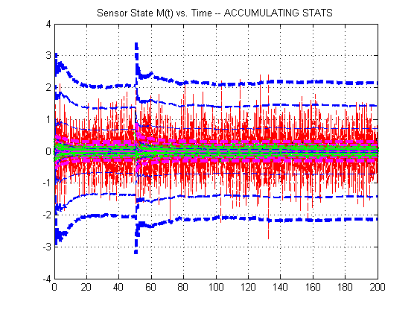
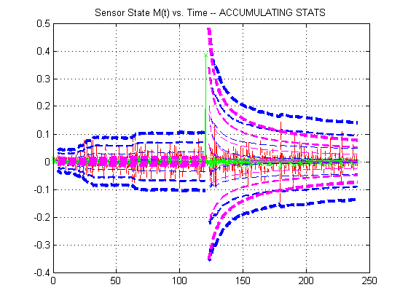
DXC'10 – Diagnostic Filters
Worst Case Dataset
Sample PHM Dataset

Slide 17
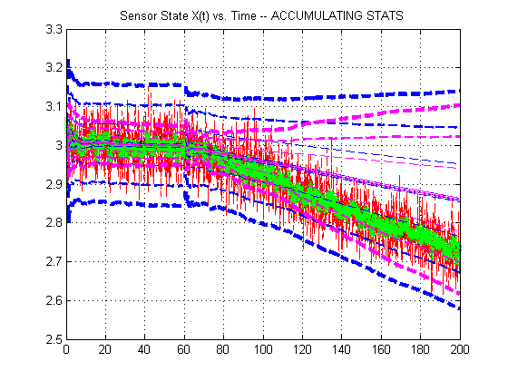
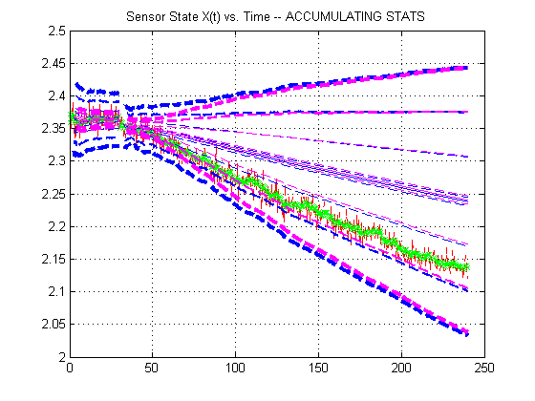
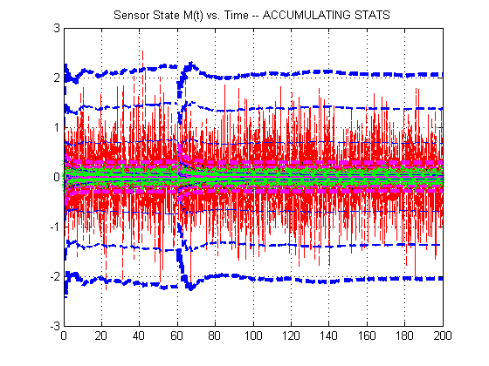
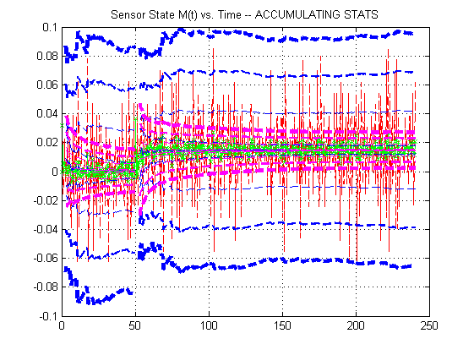
DXC'10 – Diagnostic Filters
Worst Case Dataset
Sample PHM Dataset

Slide 18
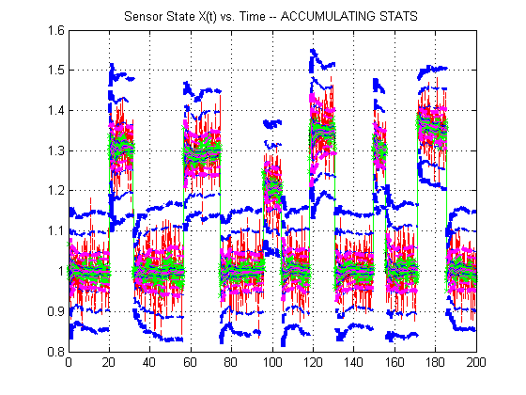
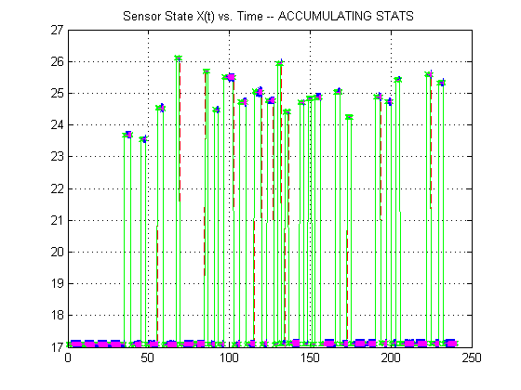
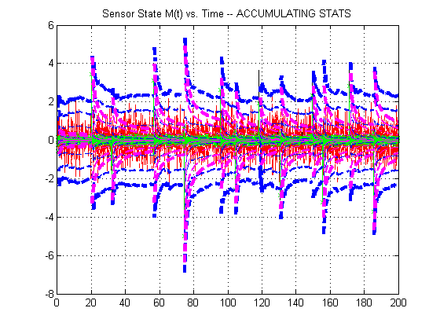
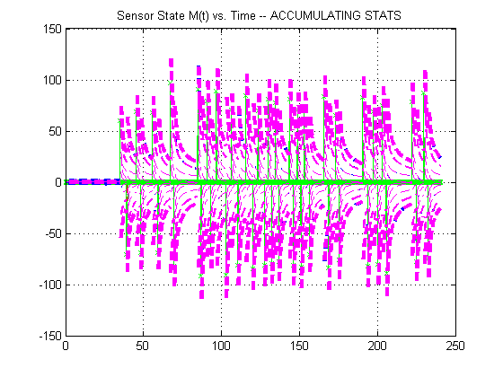
DXC'10 – Diagnostic Filters
Worst Case Dataset
Sample PHM Dataset

Slide 19
DXC'10 – Data Challenge
Data analysis problem
Based on an industrial cutter / instrumentation setup
Given: Force (in 3 dimensions), Vibration (in 3 dimensions), AE-RMS
  6 cutters, 315 cuts, 7x 50 Khz sensors
  Total of approximately 5 GBs of data
Required: Prediction of “remaining useful life” (RUL) under specified conditions
Recommended Approach:
  Given tool wear information for 3 cutters, create a model mapping cut
  characteristics to wear
  Apply model to other 3 cutters to predict wear
  From predicted wear, estimate RUL
Semi-automatic online scoring system available

Slide 20
DXC'10 – Data Challenge
Our Approaches:
First, reduce data size by calculating representative statistics from each cut file (mean, std, min, max, etc.)
Neural network
  Various combinations of testing parameters to fit data
  Various numbers of hidden levels, numbers of hidden nodes
Distribution fitting
Curve fitting with Genetic Algorithm
  Genetic Algorithm to select optimal parameters and weights
  Curve fitting algorithms to fit cut data to wear data

Slide 21
DXC'10 – Data Challenge
Data analysis problem
Based on an industrial cutter / instrumentation setup
Given: Force (in 3 dimensions), Vibration (in 3 dimensions), AE-RMS
  6 cutters, 315 cuts, 7x 50 Khz sensors
  Total of approximately 5 GBs of data
Required: Prediction of “remaining useful life” (RUL) under specified conditions
Recommended Approach:
  Given tool wear information for 3 cutters, create a model of cut characteristics to wear
  Apply model to other 3 cutters to predict wear
  From predicted wear, estimate RUL
Semi-automatic online scoring system available

